Slide 1
Sequence Diagram

Slide 2
Introduction
A sequence diagram is a form of interaction diagram which shows objects as lifelines running down the page, with their interactions over time represented as messages drawn as arrows from the source lifeline to the target lifeline.
Sequence diagrams are good at showing which objects communicate with which other objects;
And what messages trigger those communications. Sequence diagrams are not intended for showing complex procedural logic.

Slide 3
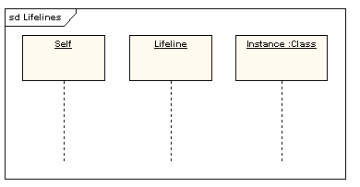
Lifelines
A lifeline represents an individual participant in a sequence diagram.
A lifeline will usually have a rectangle containing its object name.

Slide 4
Messages
Messages are displayed as arrows.
Messages can be complete, lost or found; synchronous or asynchronous; call or signal.
In the following diagram, the first message is a synchronous message (denoted by the solid arrowhead) complete with an implicit return message;
the second message is asynchronous (denoted by line arrowhead),
and the third is the asynchronous return message (denoted by the dashed line).

Slide 5
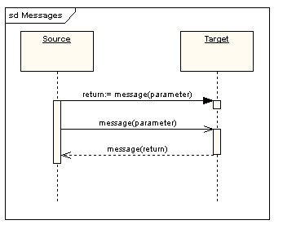

Slide 6
Execution Occurrence
A thin rectangle running down the lifeline denotes the execution occurrence, or activation of a focus of control.
In the previous diagram, there are three execution occurrences.
The first is the source object sending two messages and receiving two replies; the second is the target object receiving a synchronous message and returning a reply;
and the third is the target object receiving an asynchronous message and returning a reply.

Slide 7
Self Message
A self message can represent a recursive call of an operation, or one method calling another method belonging to the same object. It is shown as creating a nested focus of control in the lifeline’s execution occurrence.

Slide 8
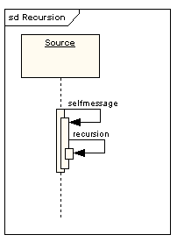

Slide 9
Lost and Found Messages
Lost messages are those that are either sent but do not arrive at the intended recipient, or which go to a recipient not shown on the current diagram.
Found messages are those that arrive from an unknown sender, or from a sender not shown on the current diagram.
They are denoted going to or coming from an endpoint element.

Slide 10
